Slide 1


Aobo Website Development Analysis

Slide 2

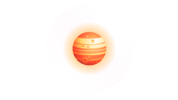
4.
Content Presentation and Functionality
2.
Page layout and navigation
1.
3.
Design Notes
Color ,Graphics and Multimedia
CONT ENTS

Slide 3

PART ONE
Design Notes
Here is my design idea

Slide 4

Design Notes
Background is set to use the white simple color scheme and other responsive button content is set in blue.
Color scheme
1.Use many different fonts
2.The main part of the paragraph adopts 'Poppins', sans-serif
3.headings use 'Roboto', sans-serif
4.different colors are used to make the overall page have obvious contrast, so that readers can more clearly capture the desired content
Fonts

Slide 5
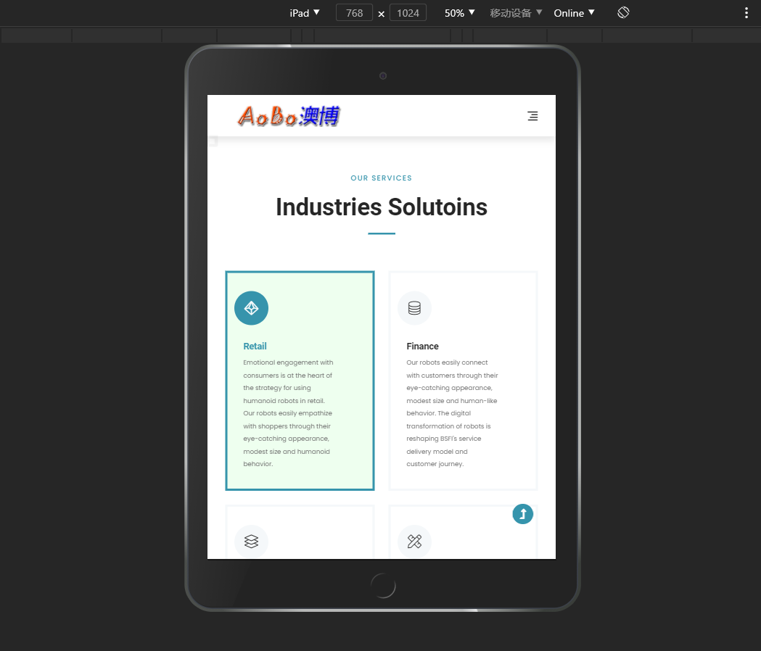
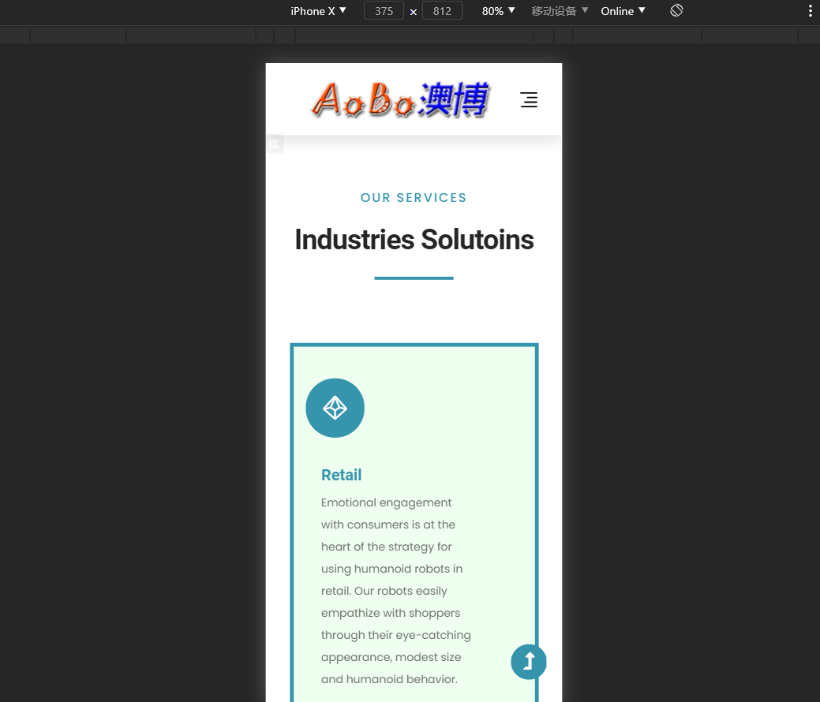
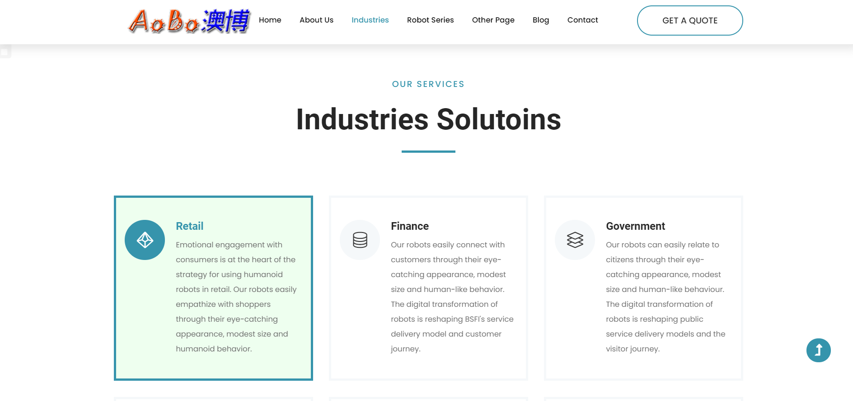
Design Notes
The text content typically centered.
The content is divided by block layout, which makes the user's browsing more intuitive and use responsive design to adapt to multiple screen resolution.
Page Format Type

Slide 6
PART TWO
Page layout and navigation
This section describes the layout and navigation of my pages

Slide 7
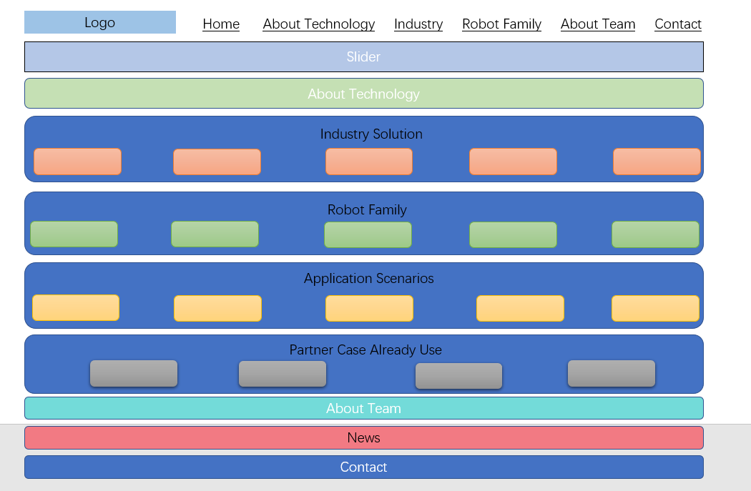
Page frame diagram
Hints:This website is just a sample website, the content is what I mainly want to express, about the slow loading of the page when it opens, I can optimize later.
This is my web page frame diagram and sample links. The web page I designed is written exactly according to my framework.

Slide 8
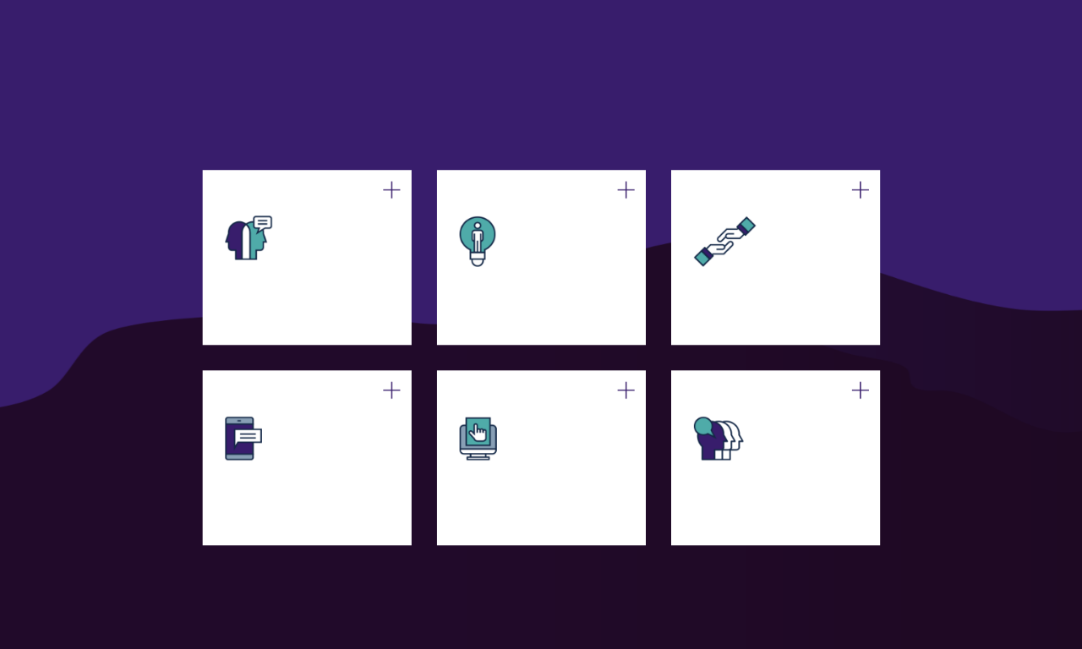
Page Layout
As for the page layout, my design ideas are as follows.
Logo
The basic part of the web page
Design principles
I designed the website with the company Logo in the top left corner.
Page title and navigation area clear, footer area information is complete.
I use basic design principles well: repetition, contrast, proximity, alignment.
Distribution of text images
Is it attractive?
Compatibility
Considering that different audiences use different devices, I design with compatibility in mind.
My text, pictures and blanks are evenly distributed, and the contrast is obvious.
I attract audiences by switching pictures on the first screen of the page.

Slide 9

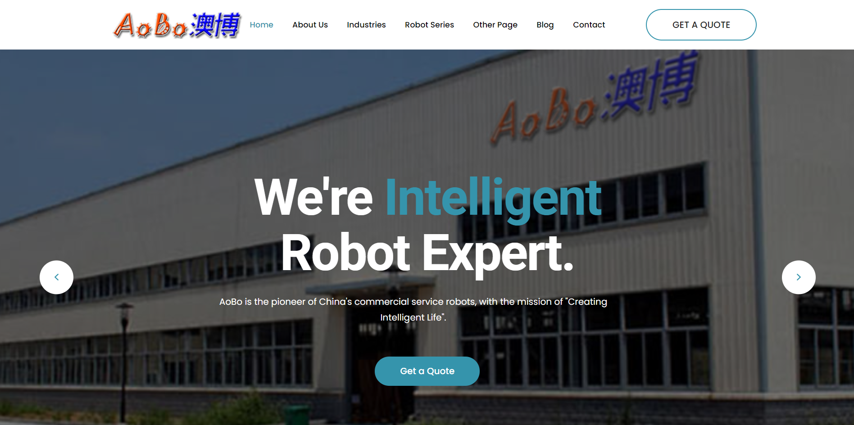
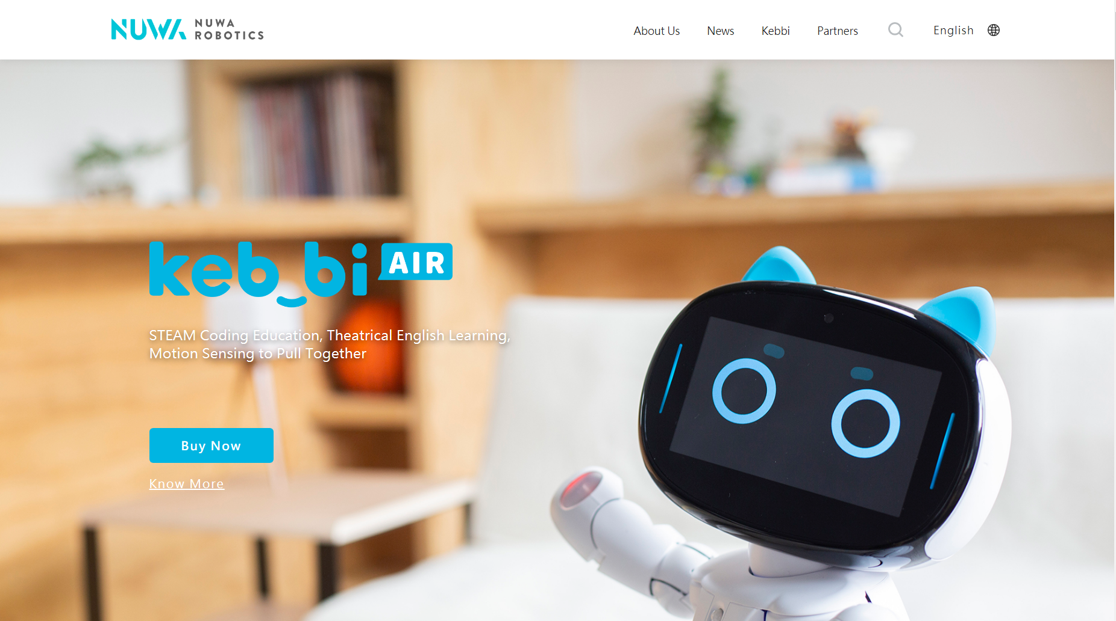
Page layout comparison
Compared to similar sites, my page layout is more appealing to my audience
As shown in the above two pictures, on the left is my first screen sketch: a rotating focus map plate, which can quickly grab the user's attention and understand the main content of this page. I can switch between videos and pictures freely on the current page.
On the right is a schematic of the same type of site. It is easy to lose the audience's interest in a single monotonous picture.

Slide 10
Navigation
Here are some ideas for my navigation section
1.
Leading Navigation Column
2.
Parent and child links are well - graded
3.
Navigation forms
Most of the shipping links I chose for this site are clearly labeled and unified.
In terms of the target audience, the site is doing well, the parent link and the child link are clear, and the people who visit the site can find what they need.
Navigation is organized as an unordered list, which allows it to work when there is no stylesheet.

Slide 11
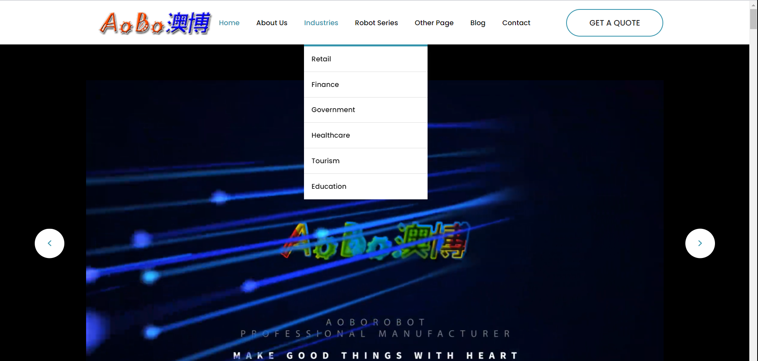
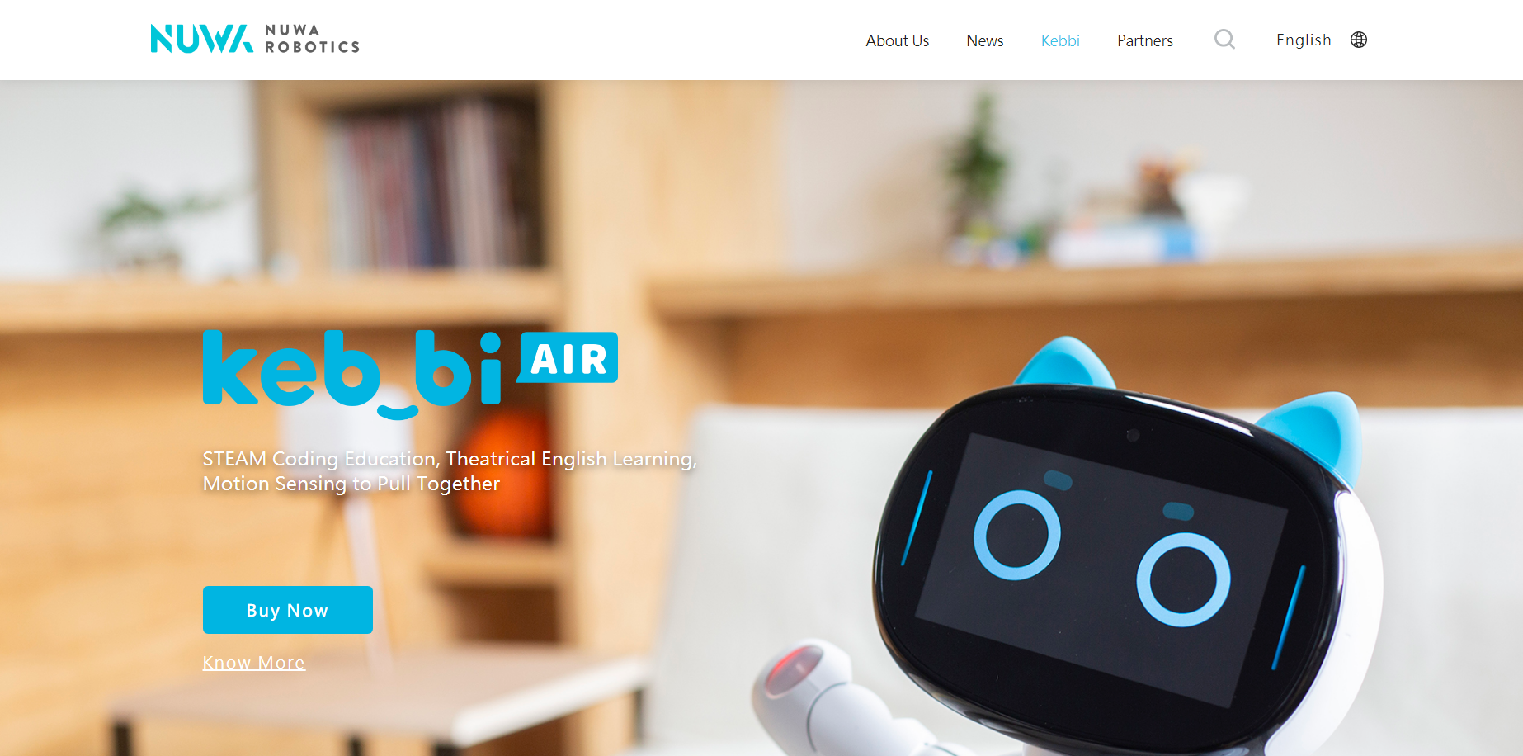
Navigation comparison
Compared to similar sites, my navigation section has an even greater advantage
As shown in the above two pictures, the left side is my navigation schematic diagram. I can switch to the content that the audience wants to see on the current page. Moreover, my navigation also has parent link and child link, which makes the navigation function more convenient for the audience.
On the right is the schematic diagram of the same type of website. The navigation part of the website conveys less information, which makes the audience unable to know the information they want clearly.

Slide 12
PART THREE
Color ,Graphics and Multimedia
This section describes the 'Use of Colour and Graphics' and Multimedia of my pages.

Slide 13
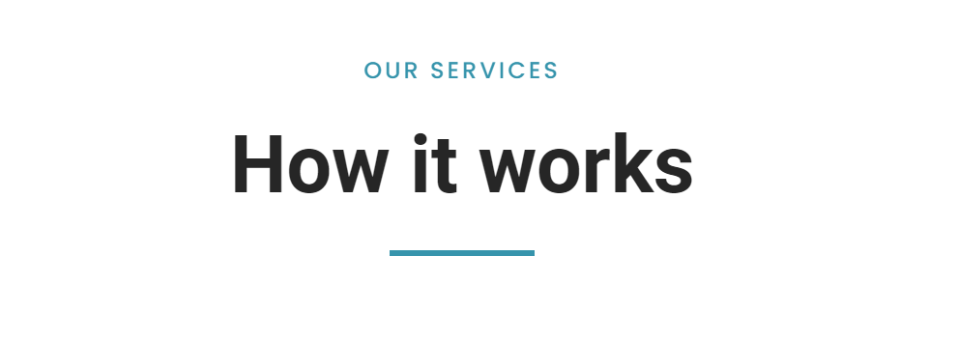
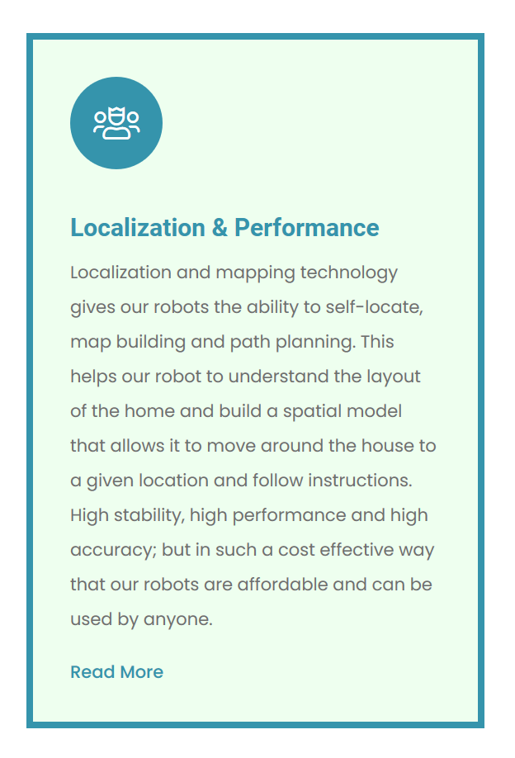
Color of web pages
The first title of the page reflects the theme color of the page. The colors are white, black, and blue. These are the three main colors of the web.
The theme colors are white, blue, and black. As shown in the picture below: white is the background color, black is the text color, blue is the border buffer color, blue is also the color, and there is also a green prompt to be selected

Slide 14
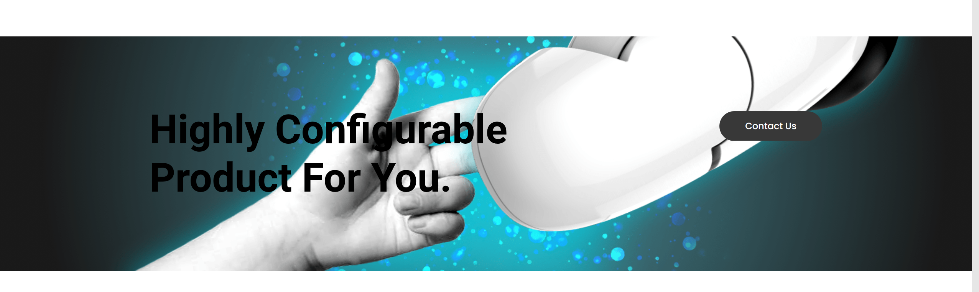
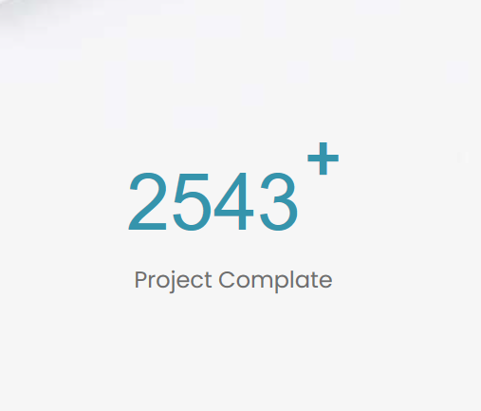
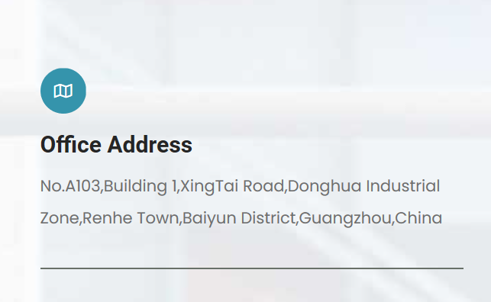
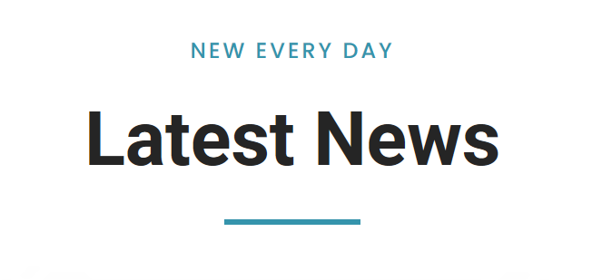
In addition, the main picture of the page also sets off the three main colors of the Page: white, blue and black, as shown in the picture below:
Moreover, there are many places where the three main color matching method：

Slide 15

Here are the three primary colors: white, black, and various shades of blue：
This web page is themed with robots. Black is the traditional text color, while white and blue are the colors with a sense of future and technology. The blue and white color palette gives the page a very consistent feel. The white that I see in the life and blue all come from the sky white cloud, the collocation of blue and white gives a person a kind of relaxed feeling, pure blue shows a kind of beauty, quiet, reason. Due to the calm characteristics of blue, with rational, accurate image, and white symbolizes peace and cleanliness. The combination of the two just highlights the sense of simplicity brought by technology
In this page, white is the background color, black is used for text and title color, and blue is to bring key information or reminder to the user

Slide 16
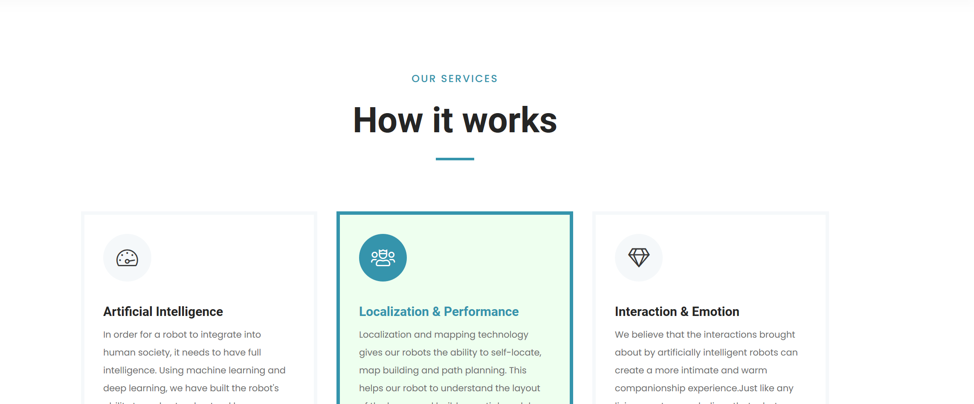
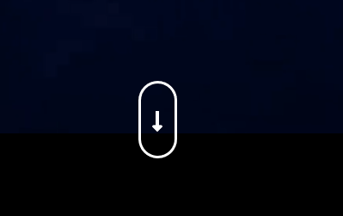
Graphics of the site
1.
The text and pictures of the site are presented in a gradual manner. Just like this text box appears
2.
After the test, the graphics display and exit did not show the situation of lag.The animation of the image is limited to the initial gradual entry, which is gentle and gradual, without distracting the user and without endless repetition
3.
Each graph of the web page has its practical meaning, most of them explain its role in the above, a few in the abstract form of the graph, as shown in the figure below, the graph is a downward arrow, its role as the jump of the "our services" section below

Slide 17
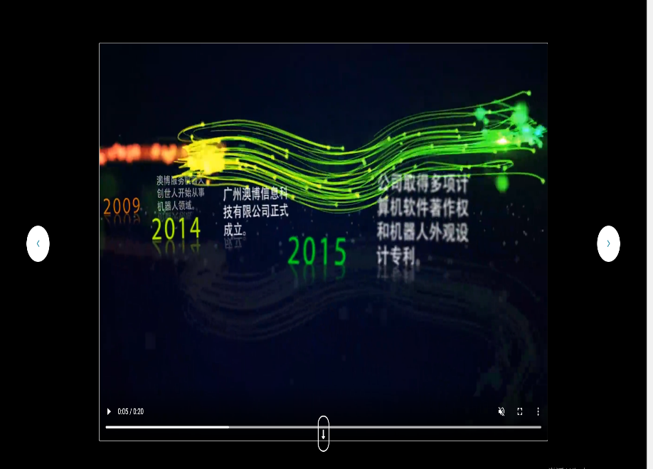
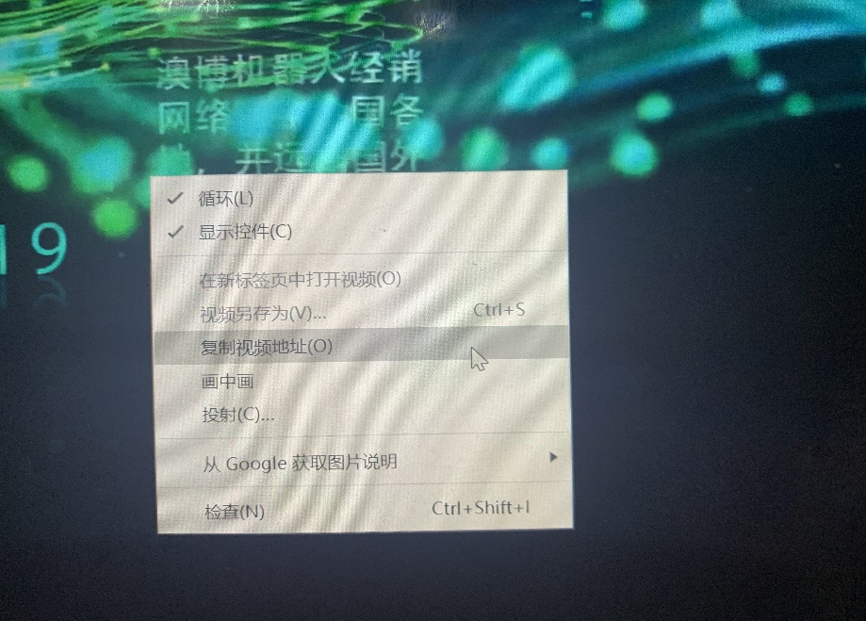
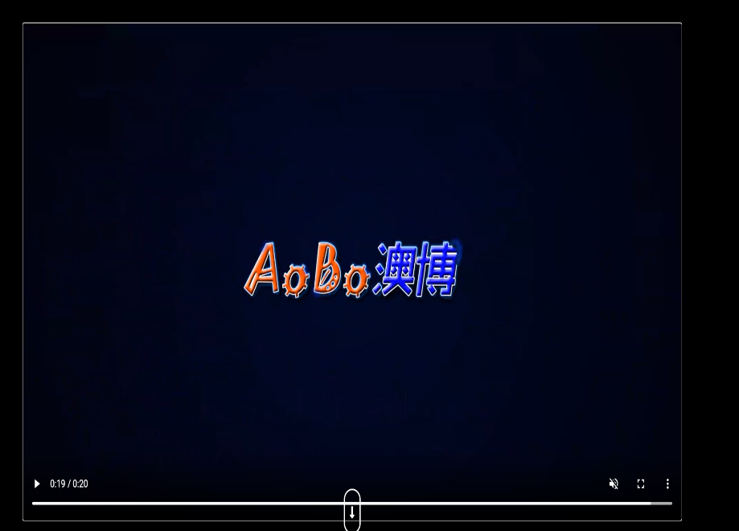
Multimedia of web pages
The video of the web page is very striking, in the introduction picture of the web page.
The purpose of this video is to explain the robotics company
As shown in the picture, since the video is located in the first section of the page, together with other pictures, it is easy to attract the user's attention. Since this video is shown alongside other pictures, the page does not use a special text box to explain the video, but as shown in the picture, the content of the video is an introduction to company
The website I designed itself does not provide a download address, but right-click videos can be downloaded.

Slide 18
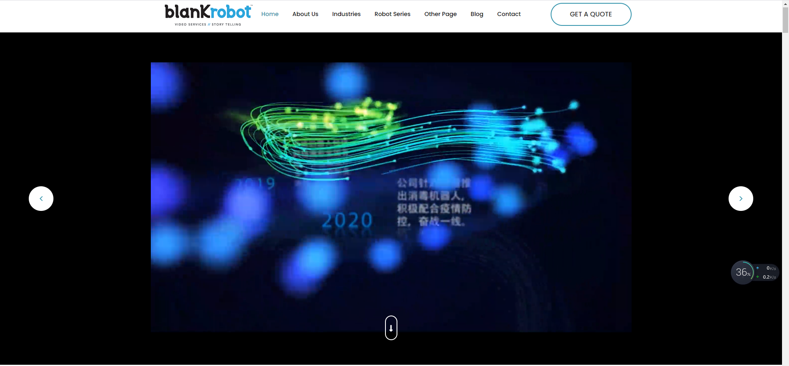
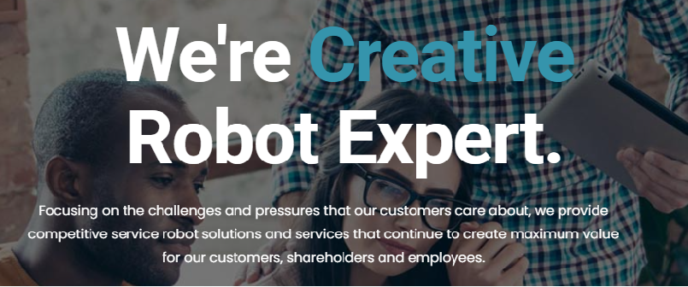
The homepage has a publicity video, which respectively introduces the following big things: the founder engaged in the field of robotics, formally established Guangzhou Aobo Information Technology Co., LTD., the company has obtained the software copyright and appearance design patent, the robot is distributed all over the country, the company launched disinfection robot in response to the epidemic.
It also briefly describes the company's mission and services.

Slide 19
PART FOUR
Content Presentation and Functionality
Here is my content presentation and functionality

Slide 20
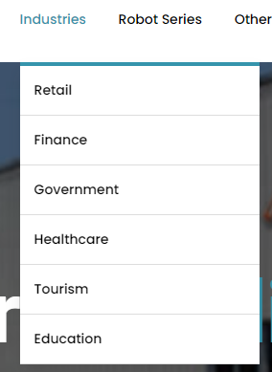
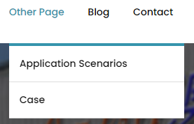
There is a LOGO near the navigation bar, and the navigation bar contains some functions includes Home, Industries, Robot Series, Other Page, Blog and Contact. By the way, The Industries contains Retail, Finance, Government Healthcare Tourism Education and Other Page contains Application Scenarios and Case.

Slide 21
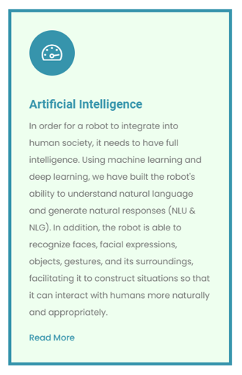
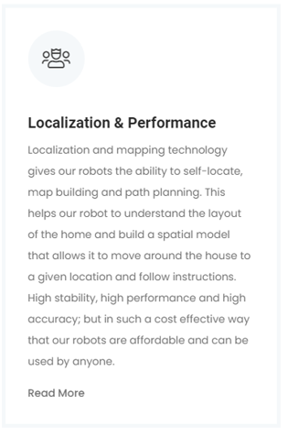
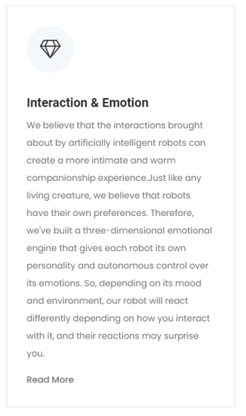
In the About Us plate, the left of it introduces us some information about what abilities artificial intelligence have to integrate into human society,
The middle of the plate introduces Localization and Performance of robots (high stability, high performance and high accuracy),
The right of the plate introduces Interaction and Emotion of robots. They believe that robots can have their emotion.

Slide 22
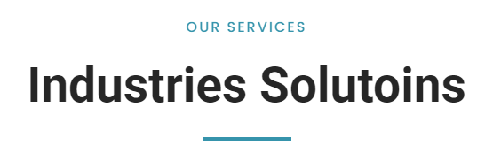
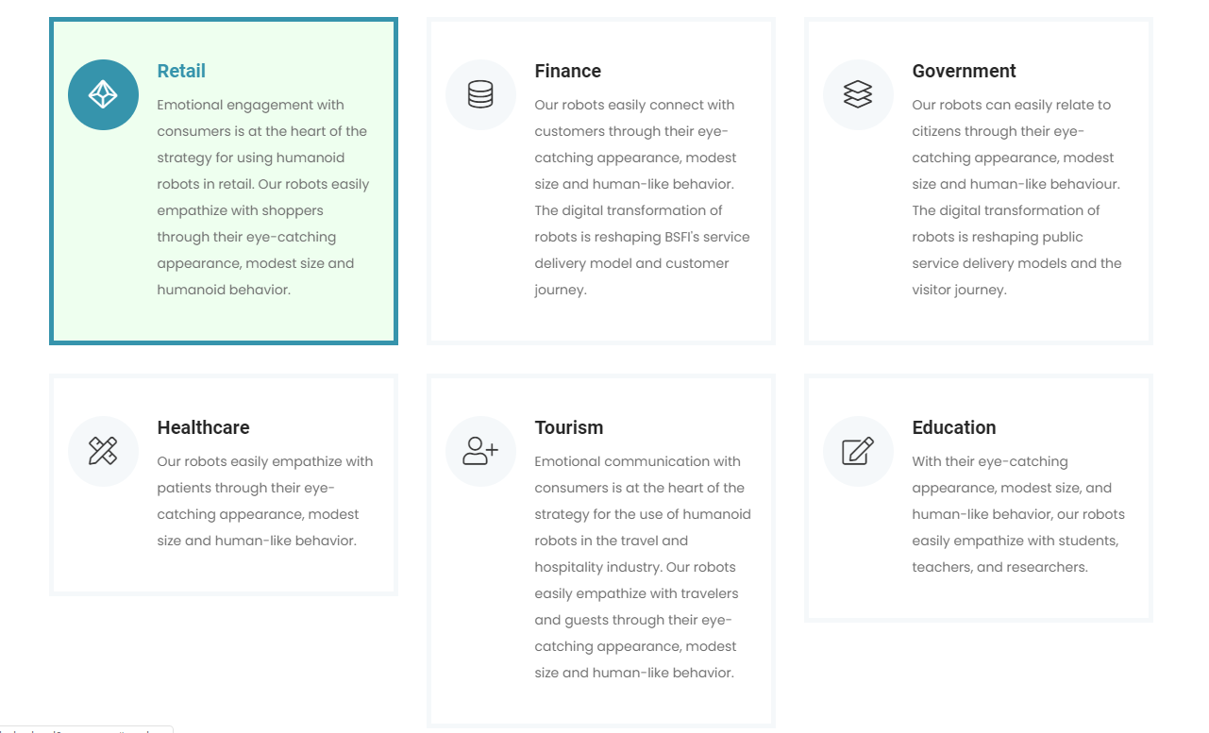
This page mainly shows about two things:
One is shows emotional engagement with consumers is at the heart of the strategy for using humanoid robots in retail.
And the other tells us robots can easily connect with customers through eye-catching appearance.
The next page displays Industries Solutions

Slide 23
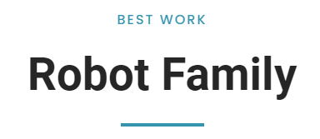
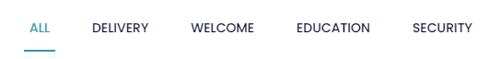
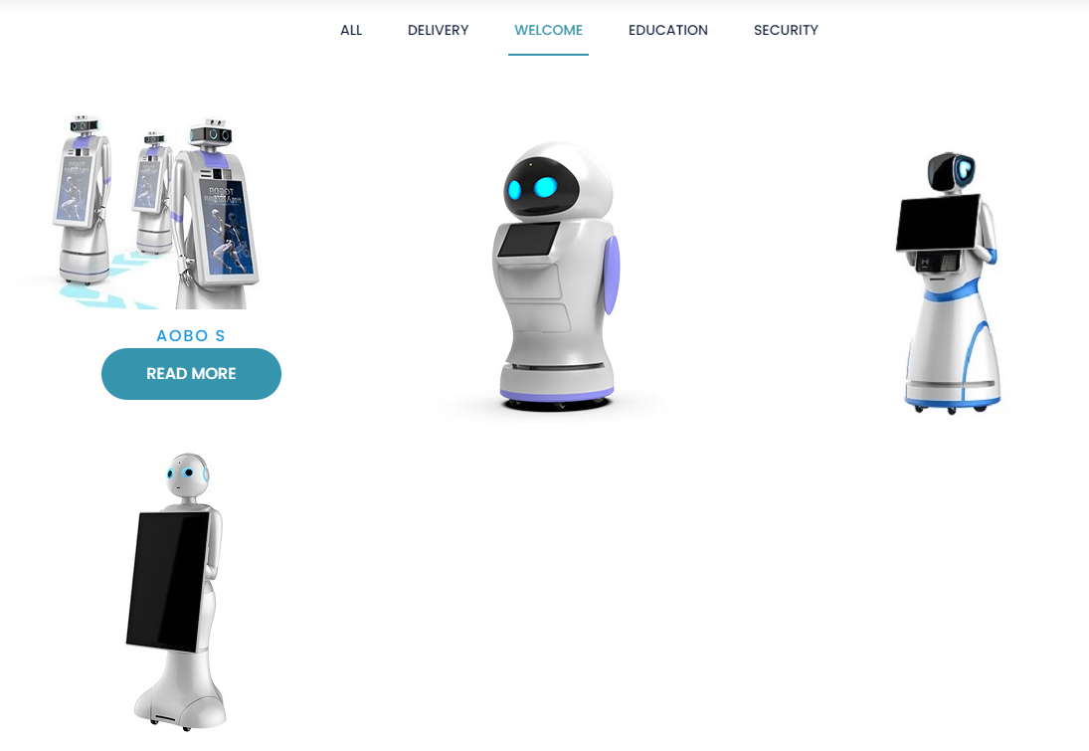
Then the next plate displays many kinds of robots for us. We can not only see the types of robots, but also can screen out what we want.
This navigation bar can let us do whatever type robots picking we want.
For example, if we choose the WELCOME robots, the page will automatically help us pick all the welcome robots for us. So we can pick robots we need conveniently.

Slide 24
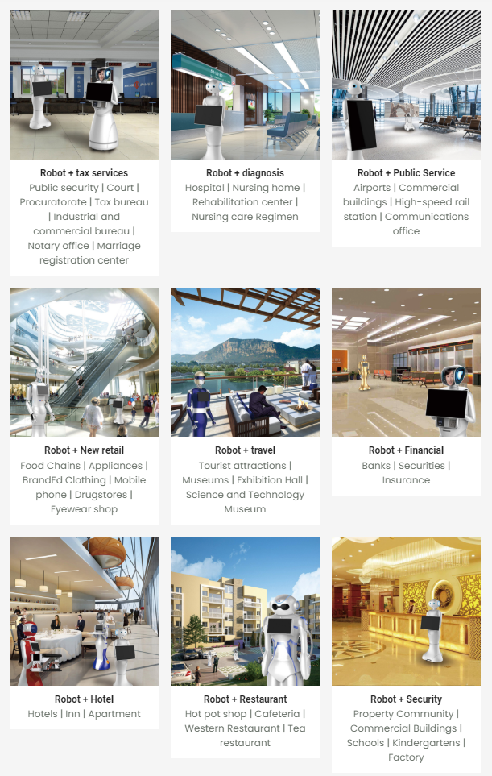
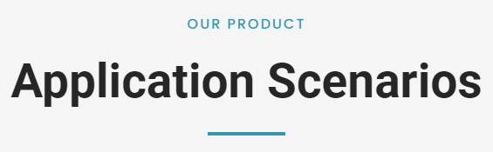
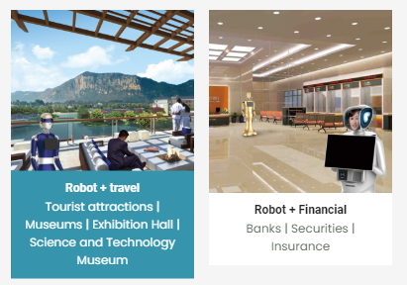
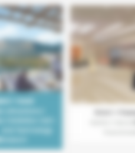
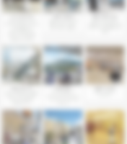

1
This plate describes where the Aobo robots can apply. And there are nine pictures of representative application scenarios below.
2
If we put the mouse over it, we will find that the picture is highlighted, which will make it clearer and more accurate for us to watch.

Slide 25
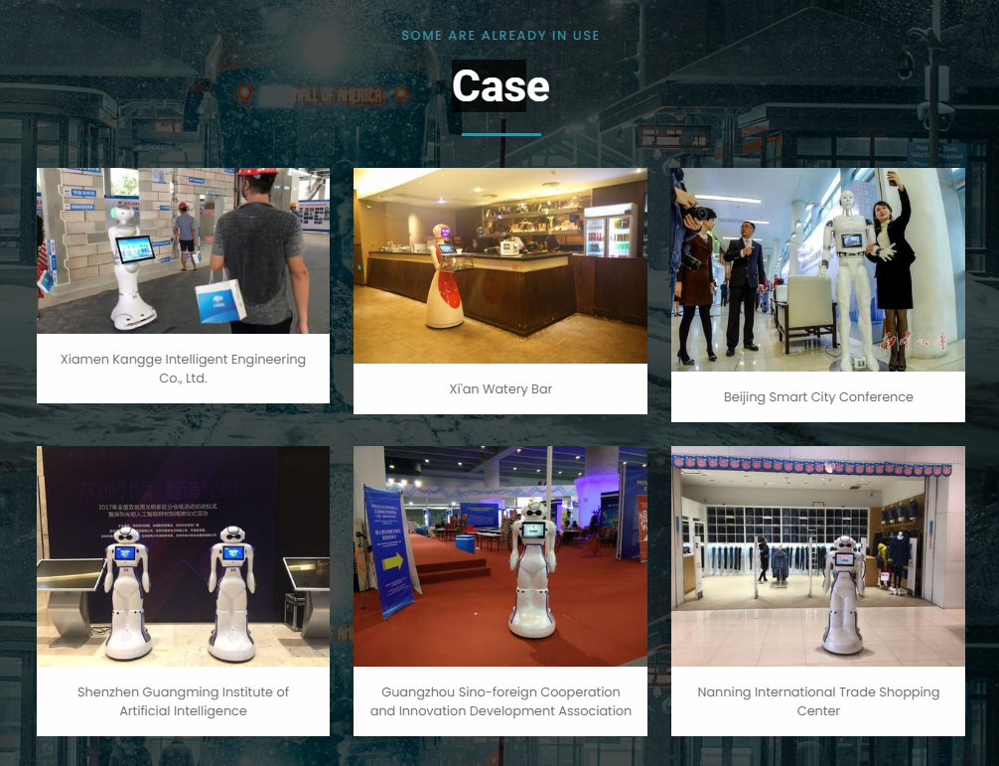
This page and the last page are both belong to Other Page function, which is on the navigation bar. They are two branches of it.
On this page we can see the robots appeared at many big cities in China include Xiamen, Xi’an, Beijing, Shenzhen, Guangzhou and Nanjing and so on.
And also, If we put the mouse over it, picture will be highlighted.

Slide 26
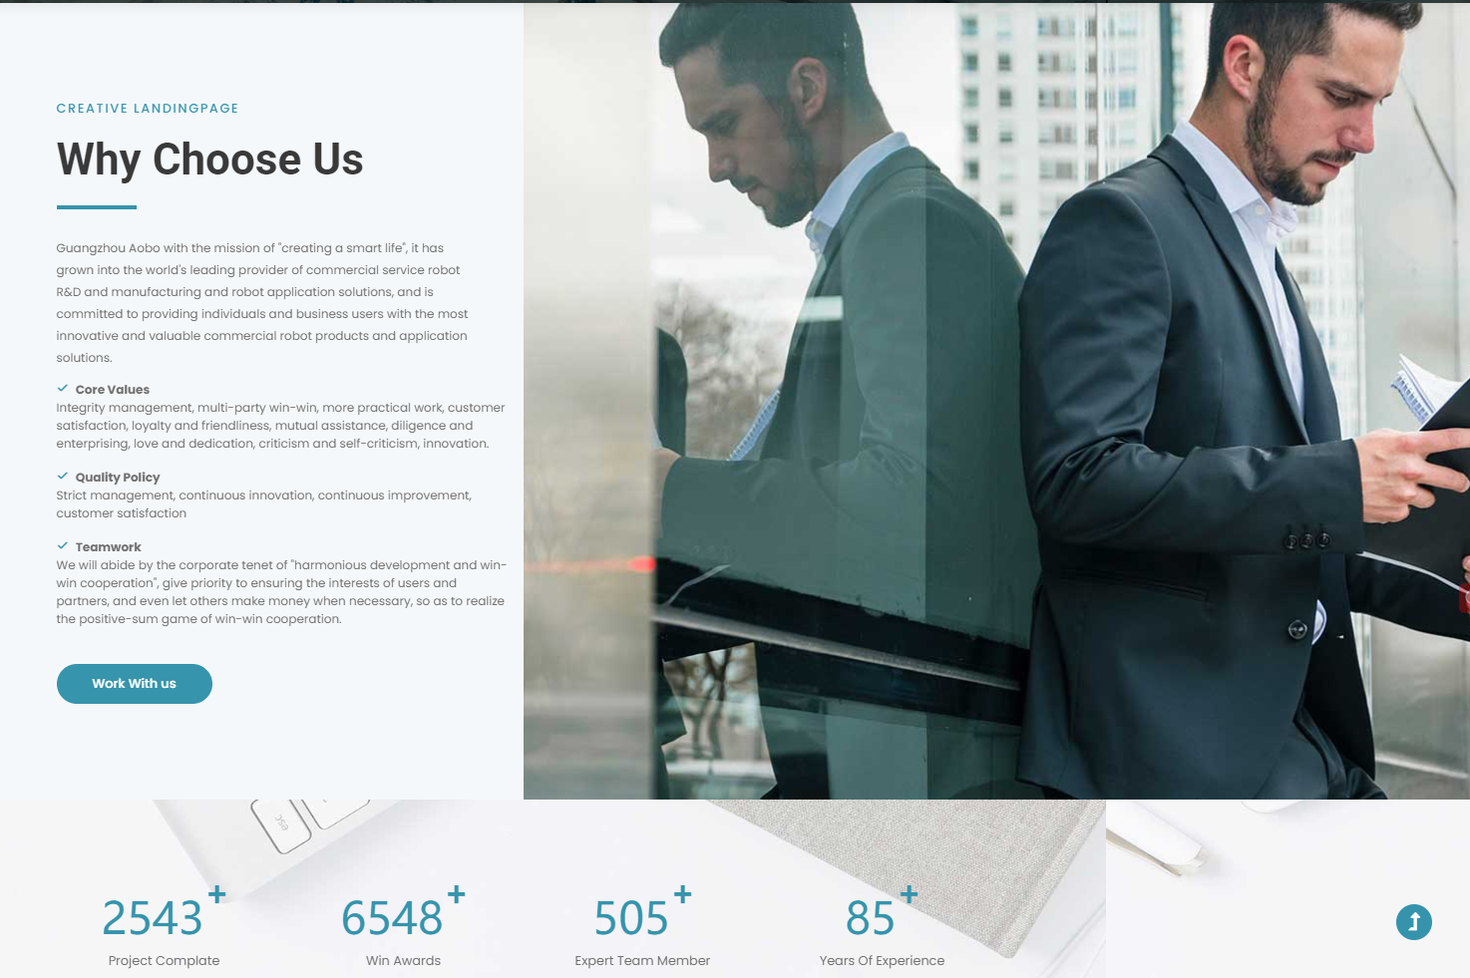
This page introduces some of reasons about why the users would rather choose Aobo robots. There are an overview and three specific reasons(Core Values, Quality Policy and Teamwork).

Slide 27
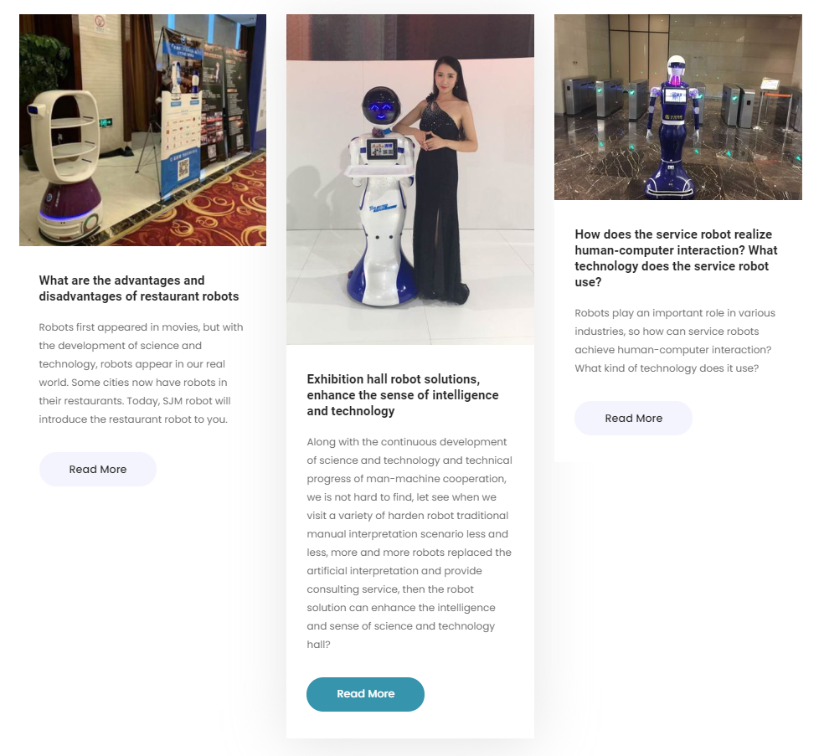
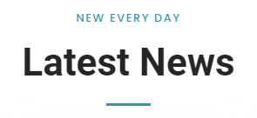
This page shows three latest news about the company:
The first is what are the advantages and disadvantages of restaurant robots.
The second is exhibition hall robot solutions, enhance the sense of intelligence and technology.
The third is how does the service robot realize human-computer interaction and what technology does the service robot use.
We can read more information by clicking it(Read More).

Slide 28
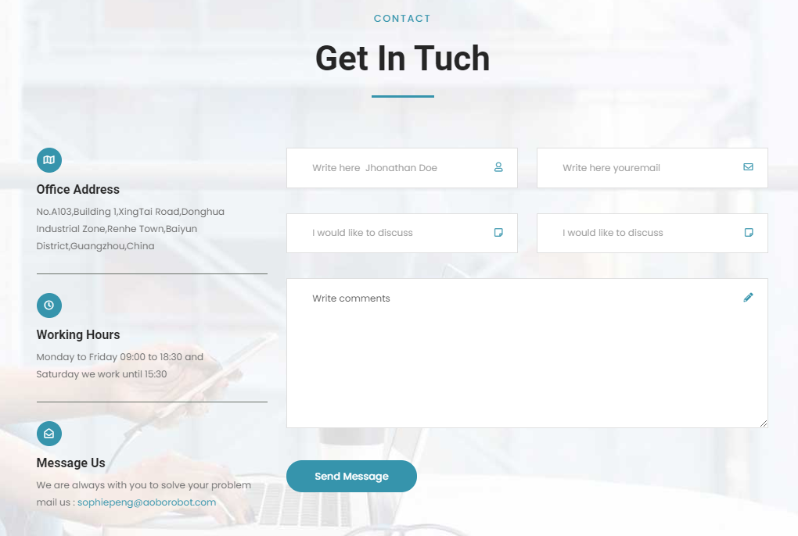
The end of the web provides us a table , which we can write our basic information on it to contact with the company.
Also, there are some information about the company:
office address(No.A103,Building 1,XingTai Road,Donghua Industrial Zone,Renhe Town,Baiyun District,Guangzhou,China),
Working Hours
(Monday to Friday 09:00 to 18:30 and
Saturday we work until 15:30)
and company’s email.

